Slide 1

A Sleep Tracking App for a Better Night's Rest
Sleep is essential for our physical and mental well-being, yet many of us struggle to get the quality rest we need. This presentation will explore how a sleep tracking app can help you optimize your sleep and transform your daily life.
By:
Sivaramakrishnan.M (Team Lead)
Dharanish.J
Subash.K
SARAN .K
Ponnarasu.R

Slide 2
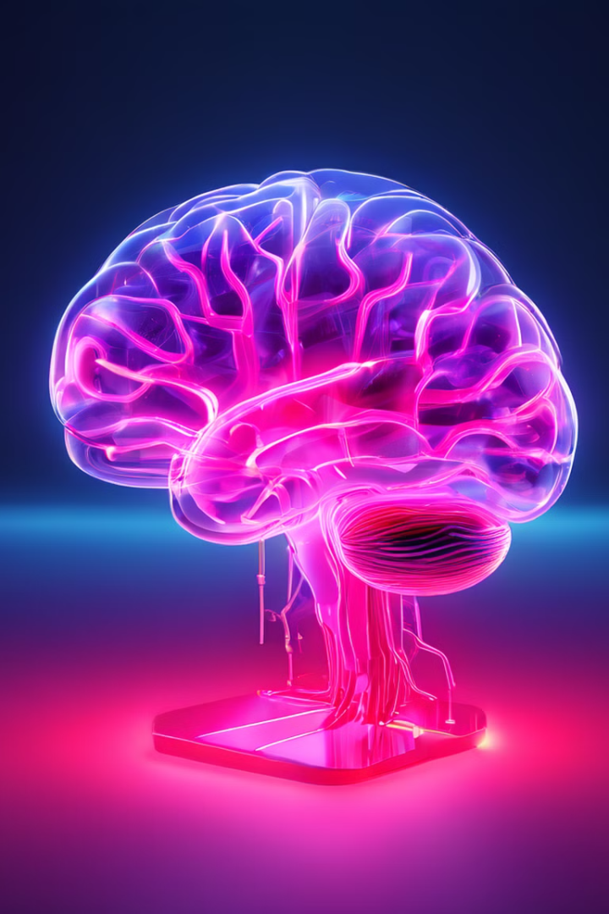
The Importance of Sleep for Health and Well-Being
1
Boosts Brain Function
2
Supports Physical Health
Quality sleep enhances cognitive abilities, memory, and overall brain health.
Proper sleep regulates hormones, strengthens the immune system, and reduces the risk of chronic diseases.

Slide 3
How a Sleep Tracking App Can Improve Your Sleep Quality
Personalized Insights
Habit Tracking
The app analyzes your sleep patterns and provides customized recommendations to optimize your rest.
Track your daily routines and behaviors that impact sleep, helping you build healthier habits.

Slide 4
Login Activity
@Composable fun LoginScreen(context: Context, databaseHelper: UserDatabaseHelper) { var username by remember { mutableStateOf(“”) } var password by remember { mutableStateOf(“”) } var error by remember { mutableStateOf(“”) } val imageModifier = Modifier Image( painterResource(id = R.drawable.sleeptracking), contentScale = ContentScale.FillHeight, contentDescription = “”, modifier = imageModifier .alpha(0.3F), ) Column( modifier = Modifier.fillMaxSize(), horizontalAlignment = Alignment.CenterHorizontally, verticalArrangement = Arrangement.Center ) { I
class LoginActivity : ComponentActivity() {
private lateinit var databaseHelper: UserDatabaseHelper
override fun onCreate(savedInstanceState: Bundle?) {
super.onCreate(savedInstanceState)
databaseHelper = UserDatabaseHelper(this)
setContent {
ProjectOneTheme {
// A surface container using the 'background' color from the theme
Surface(
modifier = Modifier.fillMaxSize(),
color = MaterialTheme.colors.background
) {
LoginScreen(this, databaseHelper)

Slide 5
Mage( painter = painterResource(id = R.drawable.sleep), contentDescription = “”, modifier = imageModifier .width(260.dp) .height(200.dp) ) Text( fontSize = 36.sp, fontWeight = FontWeight.ExtraBold, fontFamily = FontFamily.Cursive, color = Color.White, text = “Login” )
Button( onClick = { if (username.isNotEmpty() && password.isNotEmpty()) { val user = databaseHelper.getUserByUsername(username) if (user != null && user.password == password) { error = “Successfully log in” context.startActivity( Intent( context, MainActivity::class.java ) ) //onLoginSuccess() } else { error = “Invalid username or password” } } else { error = “Please fill all fields” } },

Slide 6
Registration Activity
Var username by remember { mutableStateOf(“”) } var password by remember { mutableStateOf(“”) } var email by remember { mutableStateOf(“”) } var error by remember { mutableStateOf(“”) } Column( modifier = Modifier.fillMaxSize().background(Color.White), horizontalAlignment = Alignment.CenterHorizontally, verticalArrangement = Arrangement.Center ) { Image(painterResource(id = R.drawable.tra), contentDescription = “”) Text( fontSize = 36.sp, fontWeight = FontWeight.ExtraBold, fontFamily = FontFamily.Cursive, text = “Register” ) Spacer(modifier = Modifier.height(10.dp)) TextField( value = username, onValueChange = { username = it }, label = { Text(“Username”) },
Class RegisterActivity : ComponentActivity() { private lateinit var databaseHelper: UserDatabaseHelper override fun onCreate(savedInstanceState: Bundle?) { super.onCreate(savedInstanceState) databaseHelper = UserDatabaseHelper(this) setContent { RegistrationScreen(this, databaseHelper) } } } @Composable fun RegistrationScreen(context: Context, databaseHelper: UserDatabaseHelper)

Slide 7
TextField( value = email, onValueChange = { email = it }, label = { Text(“Email”) }, modifier = Modifier .padding(10.dp) .width(280.dp) ) TextField( value = password, onValueChange = { password = it }, label = { Text(“Password”) }, visualTransformation = PasswordVisualTransformation(), modifier = Modifier .padding(10.dp) .width(280.dp) ) if (error.isNotEmpty()) { Text( text = error, color = MaterialTheme.colors.error, modifier = Modifier.padding(vertical = 16.dp) ) }
TextButton(onClick = { context.startActivity( Intent( context, LoginActivity::class.java ) ) }) { Spacer(modifier = Modifier.width(10.dp)) Text(text = “Log in”) } } } } private fun startLoginActivity(context: Context) { val intent = Intent(context, LoginActivity::class.java) ContextCompat.startActivity(context, intent, null) }

Slide 8
Main Activity
Class MainActivity : ComponentActivity() { private lateinit var databaseHelper: TimeLogDatabaseHelper override fun onCreate(savedInstanceState: Bundle?) { super.onCreate(savedInstanceState) databaseHelper = TimeLogDatabaseHelper(this) databaseHelper.deleteAllData() setContent { ProjectOneTheme { // A surface container using the ‘background’ color from the theme Surface( modifier = Modifier.fillMaxSize(), color = MaterialTheme.colors.background ) { MyScreen(this,databaseHelper) } }
@Composable fun MyScreen(context: Context, databaseHelper: TimeLogDatabaseHelper) { var startTime by remember { mutableStateOf(0L) } var elapsedTime by remember { mutableStateOf(0L) } var isRunning by remember { mutableStateOf(false) } val imageModifier = Modifier Image( painterResource(id = R.drawable.sleeptracking), contentScale = ContentScale.FillHeight, contentDescription = “”, modifier = imageModifier .alpha(0.3F), ) Column( modifier = Modifier.fillMaxSize(), horizontalAlignment = Alignment.CenterHorizontally, verticalArrangement = Arrangement.Center )

Slide 9
# Python script for sleep tracking app import sensors import analytics import rButton(onClick = { startTime = System.currentTimeMillis() isRunning = true }) { Text(“Start”) //databaseHelper.addTimeLog(startTime) } } else { Button(onClick = { elapsedTime = System.currentTimeMillis() isRunning = false }) { Text(“Stop”) databaseHelper.addTimeLog(elapsedTime,startTime) } }ecommendations
Private fun startTrackActivity(context: Context) { val intent = Intent(context, TrackActivity::class.java) ContextCompat.startActivity(context, intent, null) } fun getCurrentDateTime(): String { val dateFormat = SimpleDateFormat(“yyyy-MM-dd HH:mm:ss”, Locale.getDefault()) val currentTime = System.currentTimeMillis() return dateFormat.format(Date(currentTime)) } fun formatTime(timeInMillis: Long): String { val hours = (timeInMillis / (1000 * 60 * 60)) % 24 val minutes = (timeInMillis / (1000 * 60)) % 60 val seconds = (timeInMillis / 1000) % 60 return String.format(“%02d:%02d:%02d”, hours, minutes, seconds) }

Slide 10
Track Activity
@Composable fun ListListScopeSample(timeLogs: List<TimeLogDatabaseHelper.TimeLog>) { val imageModifier = Modifier Image( painterResource(id = R.drawable.sleeptracking), contentScale = ContentScale.FillHeight, contentDescription = “”, modifier = imageModifier .alpha(0.3F), ) Text(text = “Sleep Tracking”, modifier = Modifier.padding(top = 16.dp, start = 106.dp ), color = Color.White, fontSize = 24.sp) Spacer(modifier = Modifier.height(30.dp)) LazyRow( modifier = Modifier .fillMaxSize() .padding(top = 56.dp), horizontalArrangement = Arrangement.SpaceBetween ){
Class TrackActivity : ComponentActivity() { private lateinit var databaseHelper: TimeLogDatabaseHelper override fun onCreate(savedInstanceState: Bundle?) { super.onCreate(savedInstanceState) databaseHelper = TimeLogDatabaseHelper(this) setContent { ProjectOneTheme { // A surface container using the ‘background’ color from the theme Surface( modifier = Modifier.fillMaxSize(), color = MaterialTheme.colors.background )

Slide 11

The Future of Sleep Tracking: Advanced Features and Integrations
Biomarker Monitoring
Smart Home Integration
Cutting-edge sensors track your heart rate, breathing, and other vital signs during sleep to provide deeper insights.
The app can sync with your smart home devices to automatically adjust lighting, temperature, and other environmental factors for optimal sleep.

Slide 12

Reclaim Your Nights, Transform Your Days
Get the Rest You Deserve
Unlock Your Full Potential
Leverage the power of a sleep tracking app to achieve the quality sleep your body and mind need.
Enjoy increased focus, productivity, and overall well-being by prioritizing your sleep health.

